Slide 1


PLEDGE TO PROGRESS Sustainability Hackathon
Sponsored By
Your Team Name :Sagaya Arul Sophia.k
Your team bio: Agriculture Industry Transformers(AIT)
A Team which has Developers, Managers and Leaders
And the Entrepreneurship of the startup Spaceyme.com
Date:29-04-2023

Slide 2
Problem Statement?
Why did you decide to solve this Problem statement?
Problem:
The Rise in Earth Temperature’s and emission of CO2 have affected agricultural productivity
As stated by Indian Express “At this time of the year, the burning of agricultural waste in Punjab and Haryana is indeed the dominant reason for the smoke and haze over Delhi. The particulate matter from the burning contributes 30-40% of the PM2.5 concentrations in Delhi’s air during this time. It is the single largest source of PM2.5 levels on most days during this period.”
Decision To Solve
I am moved by the Framer’s common people’s suicide, Diseases due to malnutrition and poverty from an agricultural background and watching the news about pollution and affecting people’s health care. So I Love to share my knowledge of Technology which can help many people and everyone to have zero polluted or very negligible polluted environment. Want to Build a Green Smart System for Agro Industry which can benefit another industry process like Healthcare, manufacture etc.
Ref:Agro-Industrial Wastes Industry (eiriindia.org)

Slide 3
User Segment & Pain Points
Agiculturist
Industrialist
Environmentalist Impact Analyzer
Yield Reduction and loss due to natural calamities
Rare species crop cultivation machinery not available manual effort.
Climate change and Pollution from Agricultural waste
Materials and process for manufacture cost is High
Industrial waste is a major contributor to Climate change and Pollution
Healthcare industry claims are high due to disease
The population affected people and children due to Malnutrients and the en affectsent affect the future generation's children and youth.
The connectivity between industries and solution is huge Gap for sustainable Environment Building.
.In process to crate balanced Environment for every living being.
Amore balanced and sustainable Economic Growth
Which user /advertiser segment would be early adopter of your product & why?

Slide 4
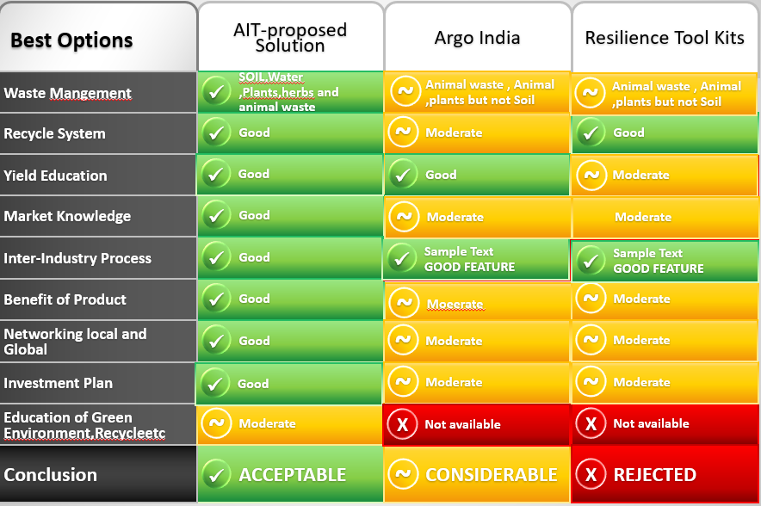
Pre-Requisite
What are the alternatives/competitive products for the problem you are solving?
This a new system but some features have same as like the other agro products as shown below

Slide 5
Tools or resources
Azure tools or resources which are likely to be used by you for the prototype, if your idea gets selected
Components | Technology
Hardware | Cloud and IOT
Software | Java and J2EE, Google Analytics
OS | IOS,Android,windows, Linux and Mac

Slide 6
Any Supporting Functional Documents
Present your solution, talk about methodology, architecture & scalability

Slide 7
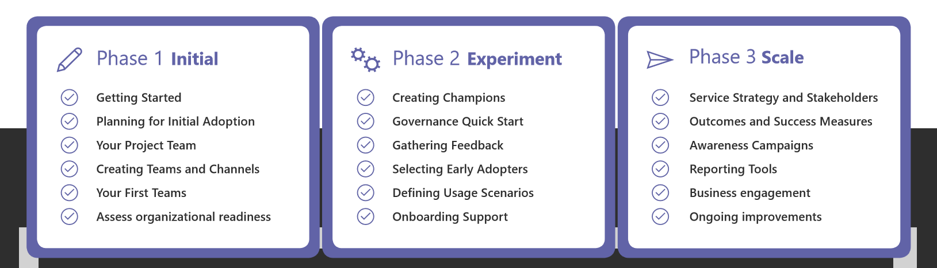
Key Differentiators & Adoption Plan
How is your solution better than alternatives and how do you plan to build adoption?
Plan to use the Microsoft Adoption Tool Kit templates
Schedule Service Health reviews

Slide 8
GitHub Repository Link & supporting diagrams, screenshots, if any
How far it can go?
Phase | Activity Planed | ETA 2023-2024
Phase1 :1 | Requirement Analysis Review feature validation | Q32023
Phase 1:2 | Data Modelling and Analytics | Q3&Q42023
Phase1:3 | Design System Model Prototype model 1 | Q3 &Q42023
Phase 1:4 | Test and Collect Feedback Prototype Release model 1 | Q32024

Slide 9
Thank You
Sagaya Arul Sophia /spaceyme.com

